Slide 1

CyberSecurity Data breach Data Analysis
Justin Brose – ISDS 3200

Slide 2

About The Data Set
This data set contains entries of data security breaches carried out from the years 1997 – 2014. This data set originally contained 13 columns but was later trimmed down to 9 columns in order to only display data that was pertinent to the questions that were posed and rid the data set of numerous NULL values.

Slide 3
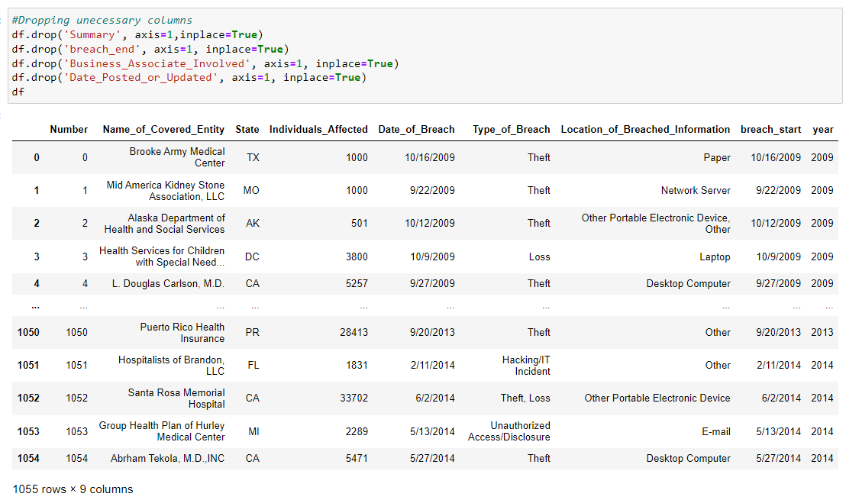
Clean up
As mentioned before the dataset was trimmed of the unnecessary columns. To the right is an image of the python code used to remove extra columns.

Slide 4
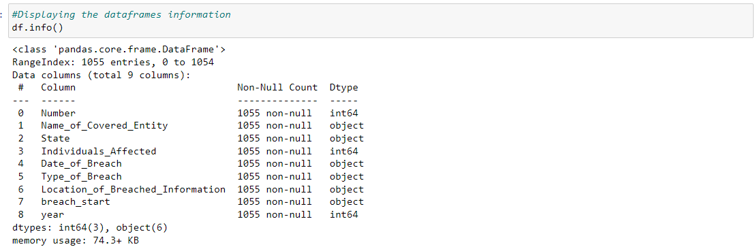
Data set information

Slide 5
DateTime Conversion

Slide 6

Types of Analytical Questions
Easy (Questions 1-4)
Medium (Questions 5-7)
Complex (Questions 8-10)

Slide 7

Easy Questions (Questions 1-4)

Slide 8
1.) What is the First Date stated in the dataset?
In order to better understand the range of time in this dataset. My first question aimed to find what the first date in the dataset was. I found that the earliest date stated was 1-1-1997.

Slide 9
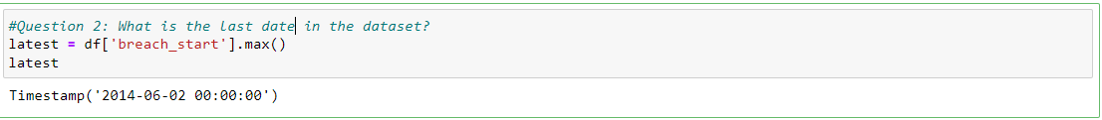
2.) What is the last date in the dataset?
The second question, similar to the first, asks to find the last date in the dataset. It appears that 6/2/2014 was the last year recorded in the data set.

Slide 10
3.) How many total individuals were affected by data breaches?
This questions seeks to find the total number of individuals that were affected by a data breach within the dataset. I found that over 31 Million people were affected by some form of data breach between the years 1997 – 2014.

Slide 11
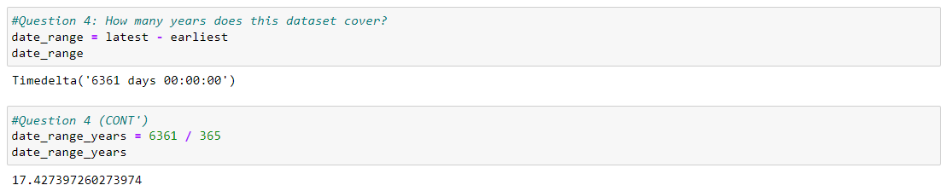
4.) How many years does this dataset cover?
A little more datset familiarity here. I found that the dataset covers 6361 days or a little under 17.5 years.

Slide 12

Medium Questions (Questions 5-7)

Slide 13
5.) How many unique states were affected by (a) data breach(es)?
In this question we want to know what states experienced at least one data breach between the years 1997 – 2014. I found that all 50 states were affected by data breaches. I also found that this dataset includes both Washington D.C. and Puerto Rico as 'States'.

Slide 14
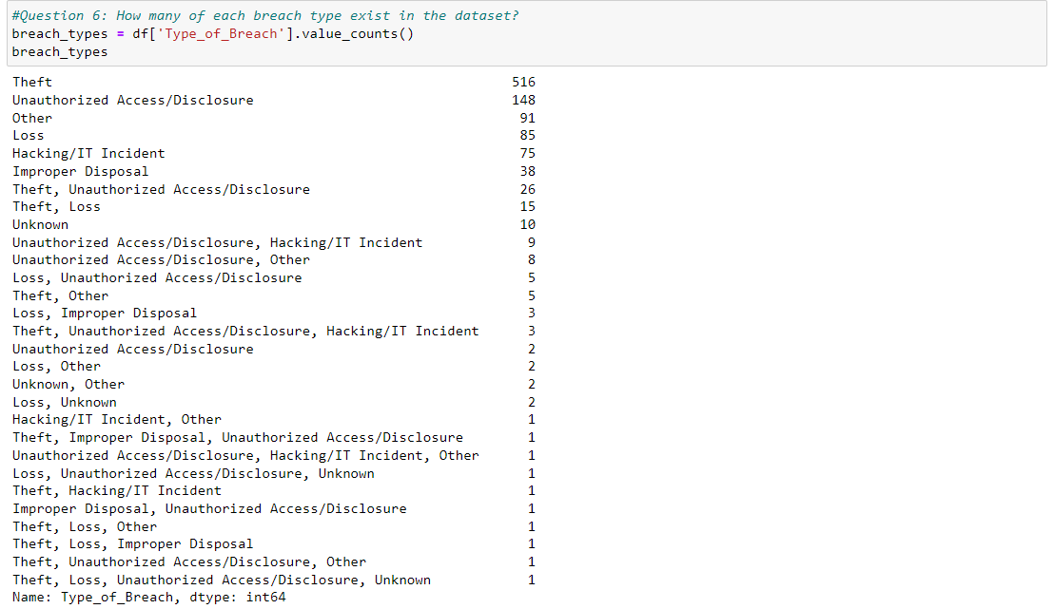
6.) How many of each breach type exists in the dataset?
In this questions we are, again, getting a little more familiar with the data inside the dataset. In order answer this question, I found that the value_counts function was quite useful.

Slide 15
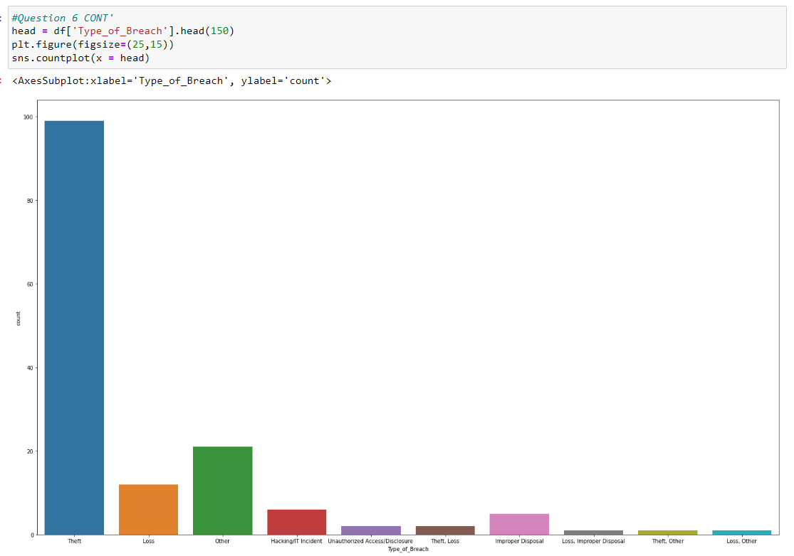
6. CONT') How many of each breach type exists in this data set
I also decided to display this data graphically.
I found that if I tried to display all data types then the titles at the bottom would overlap. Thus, I had to limit the data to the first 150 entries.

Slide 16
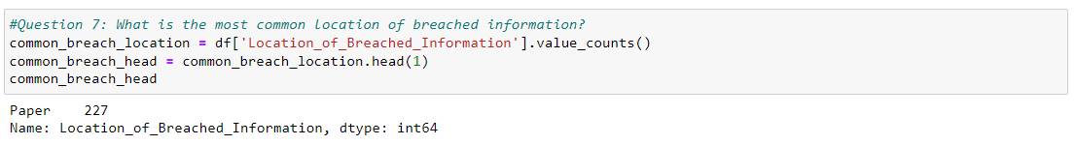
7.) What is the most common location of breached information?
In this questions we wish to find what medium was most vulnerable between the years 1997 – 2014. This ultimate result is that paper was the most vulnerable with 227 instances of it occurring in this dataset.

Slide 17
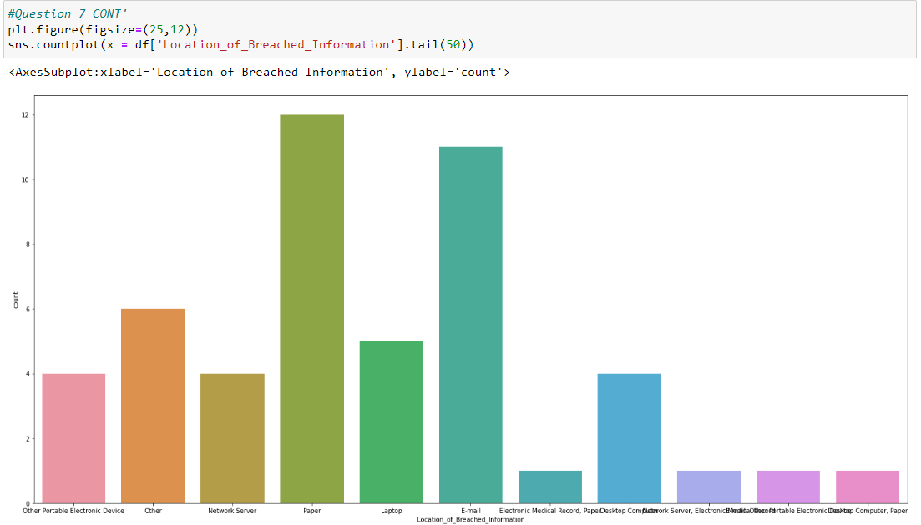
7 CONT'.) What is the most common location of breached information?
Here is the previous results graphically represented. As you can see paper barely wins over the other breached locations. Again, I had to display the tail of the information to make the graph mostly legible.

Slide 18

Complex Questions (Questions 8-10)

Slide 19
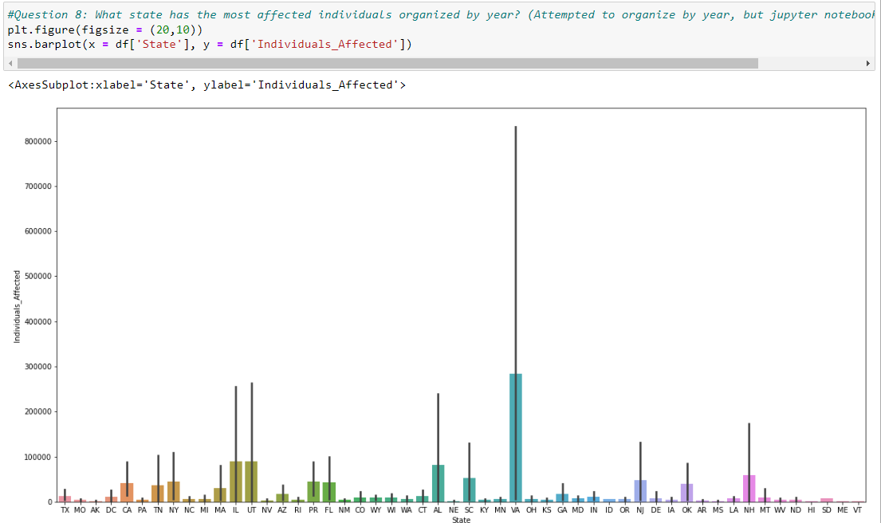
8.) What state had the most affected individuals organized by year?
Originally, I planned to organize this by year, however, after attempting to input that into jupyter notebook I realized that running this would take too much time to process. Then, I thought about the question a little more and I came to the conclusion that organizing this by year would draw attention away from what I really wanted to show.
In the end, I found that Virgina was the most affected state in this dataset.

Slide 20
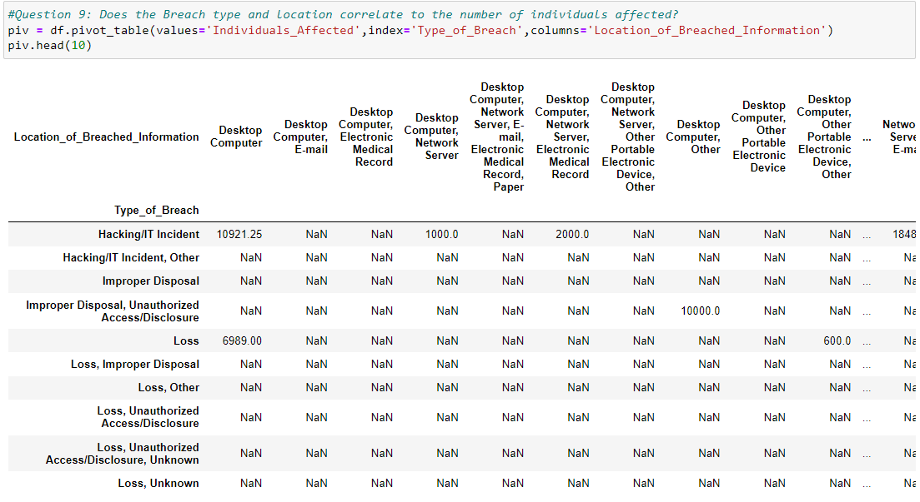
9.)Does the breach type and breach location correlate to the number of individuals affected?
Since this question has three variables, I saw it useful to create a pivot table that I could then transfer to a heatmap.
Overall, this was mostly successful except I ran into an issue where values from the 'Individuals_affected' column were returning as 'NaN'.
I went back to check all the records and they were indeed integers, so I am unsure what went wrong in this situation.
Nevertheless, I still created the heatmap (next slide).

Slide 21
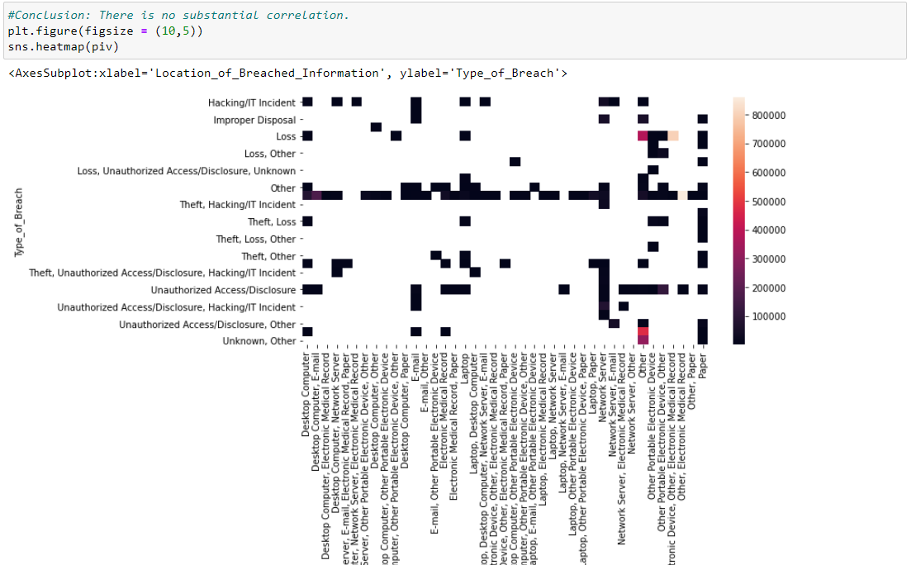
9 CONT'.) Does the breach type and breach location correlate to the number of individuals affected?
My conclusion to this question is that there is no substantial correlation.

Slide 22
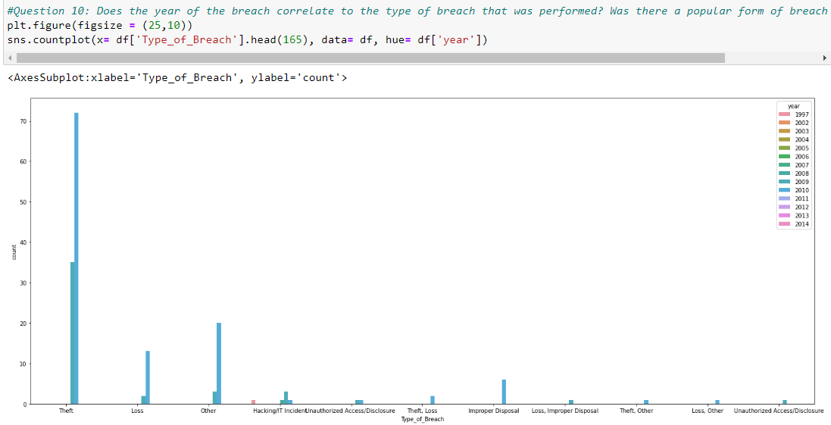
10.) Does the year of the breach correlate to the type of breach? Was there a popular breach type in a particular year?
Ultimately, I believe I was successful with answering this question. Once more, the number of breach_types posed an issue when trying to make the graphs legible, so I had to display the first 165 entries of the data set.
I was able to find that in the year 2010 theft was a very popular form of data breach. It is displayed that about 75 entries of theft were recorded within the first 165 records.

Slide 23

Thank You!
Please address all questions to:
Jbrose1@lsu.edu

